Slide 1
Setting Up a Web &
PROJECT OVERVIEW
Part 1 — Domain Name
DNS Server on Linux
Part 2 — BIND9 Install
Part 3 — DNS Config
Part 4 — Apache
CTEC 435 3/6/2026
Part 5 — Virtual Hosting
Part 6 — SSL/TLS
By: Ethan Haskell
Part 7 — Access Control
Part 8 — MySQL
Part 9 — phpMyAdmin
Part 10 — WordPress

Slide 2
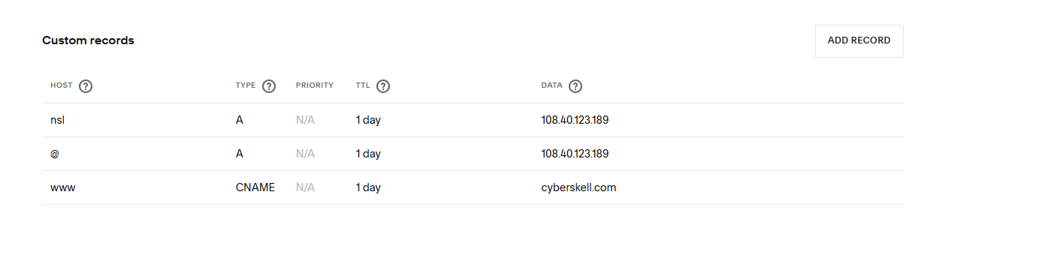
Acquiring a Domain Name
I purchased a domain name (cyberskell.com from Squarespace and configured with custom DNS records pointing to the server's public IP address.
DNS RECORDS CONFIGURED
Registrar:
Squarespace
Domain:
cyberskell.com
Public IP:
108.40.123.189
A Record:
@ → 108.40.123.189
A Record:
ns1 → 108.40.123.189
CNAME:
www → cyberskell.com

Slide 3
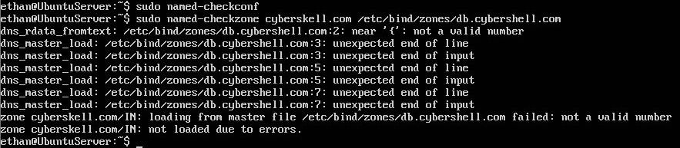
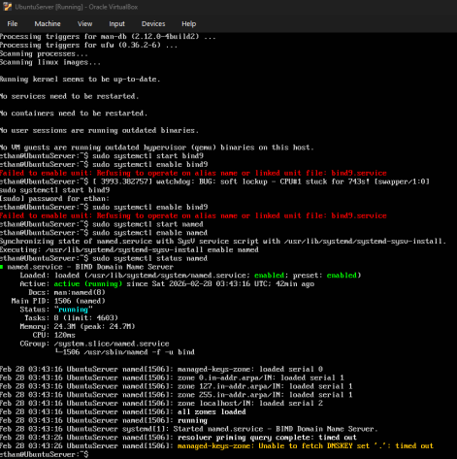
Installing & Configuring BIND9 DNS Server
COMMANDS USED
sudo apt install bind9 bind9utils
The name changed from 'bind9' to 'named’ inside of Ubuntu server so when I tried to use the original commands like sudo systemctl start bind9 it didn’t work. I had to use: sudo systemctl start named
sudo systemctl start named
sudo systemctl enable named
sudo named-checkconf
sudo named-checkzone cyberskell.com \/etc/bind/zones/db.cyberskell.com
dig cyberskell.com @localhost

Slide 4
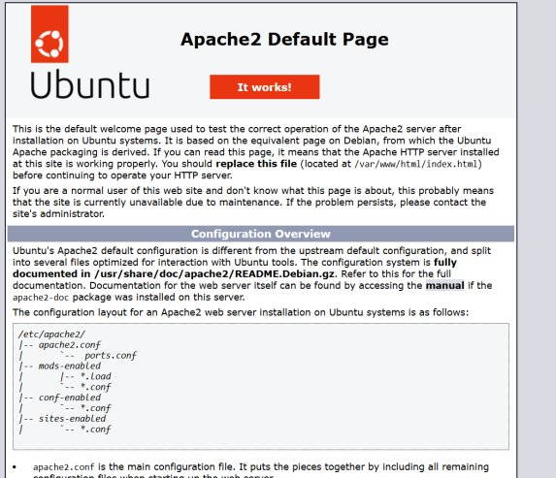
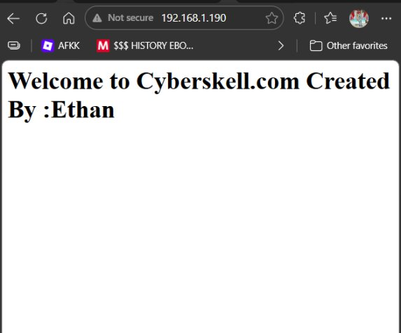
Apache Web Server & Virtual Hosting
INSTALLATION & CONFIG STEPS
Install Apache
sudo apt install apache2
Enable Service
sudo systemctl enable apache2
Create Document Root
sudo mkdir -p /var/www/cyberskell.com
Create VHost Config
/etc/apache2/sites-available/cyberskell.com.conf
Enable VHost
sudo a2ensite cyberskell.com.conf
Disable Default Site
sudo a2dissite 000-default.conf
Reload Apache
sudo systemctl reload apache2

Slide 5
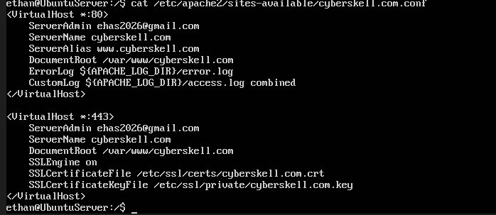
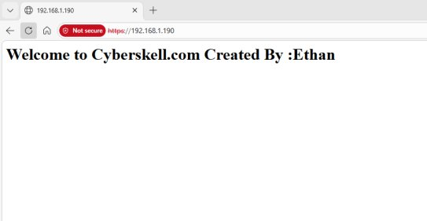
Securing Apache with SSL/TLS
SSL SETUP STEPS
1. Generate Self-Signed Cert
sudo openssl req -x509 -nodes
-days 365 -newkey rsa:2048
2. Enable SSL Module
sudo a2enmod ssl
3. Add VHost *:443 Block
SSL VirtualHost Configuration
SSLEngine on
SSLCertificateFile
SSLCertificateKeyFile
4. Reload Apache
sudo systemctl reload apache2
5. Test in Browser
https://192.168.1.190
HTTPS page loaded successfully

Slide 6
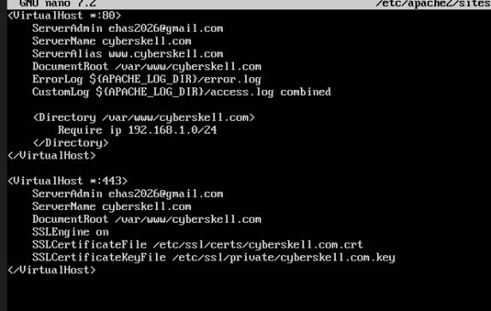
Access Control by Source IP Address
HOW IT WORKS
The <Directory> block inside the VirtualHost restricts access based on the client's source IP address.
<Directory /var/www/cyberskell.com>
Require ip 192.168.1.0/24
</Directory>
Allows all devices on 192.168.1.0/24 subnet
Blocks all other IP ranges
Tested successfully from laptop and other local devices
Applied to both HTTP and HTTPS virtual hosts this allowed the server to be accessed across both ports
VHost config with IP restriction applied

Slide 7
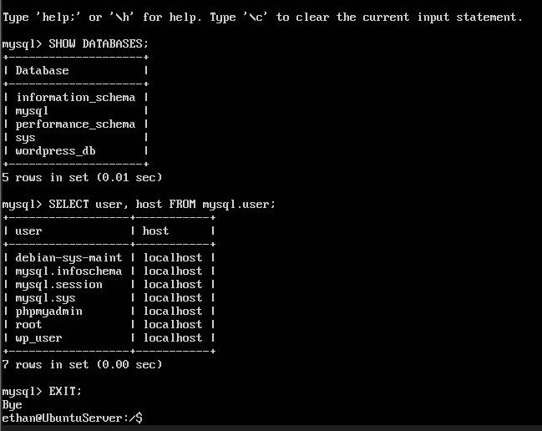
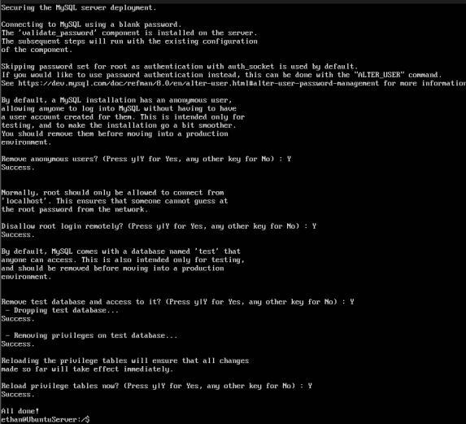
Installing & Securing MySQL Server
mysql_secure_installation output
Database and user creation
MYSQL SETUP
Install MySQL
sudo apt install mysql-server
Secure Installation
sudo mysql_secure_installation
Create Database
CREATE DATABASE wordpress_db;
Create User
CREATE USER 'wp_user'@'localhost'
IDENTIFIED BY 'password';
Grant Privileges
GRANT ALL PRIVILEGES ON
wordpress_db.* TO 'wp_user'@'localhost';
Apply Changes
FLUSH PRIVILEGES;

Slide 8
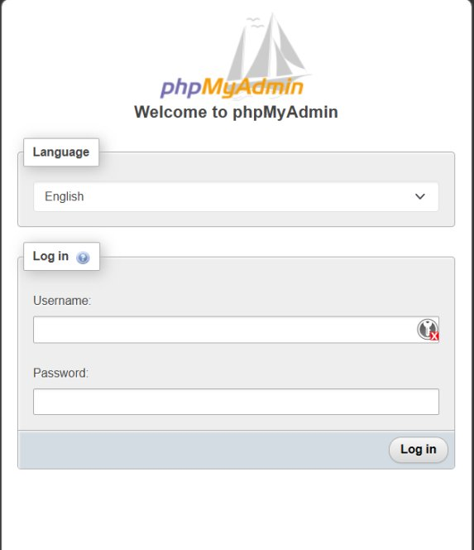
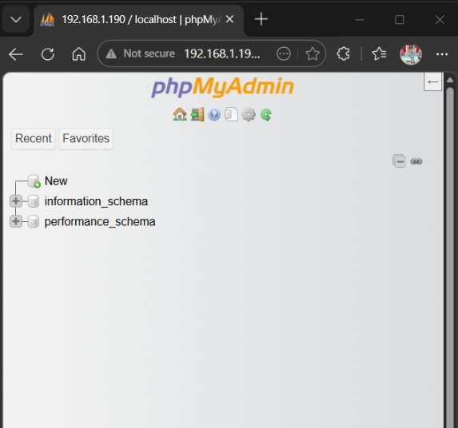
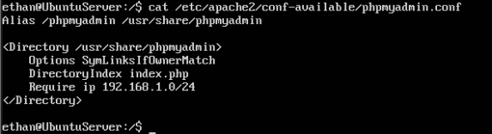
Installing & Securing phpMyAdmin
IP Restriction Config
phpMyAdmin Dashboard
INSTALLATION and Securing phpMyadmin
Installed via: sudo apt install phpmyadmin — selected apache2 as web server during setup and completed confirguation
phpMyAdmin symlinked using : sudo ln -s /usr/share/phpmyadmin /var/www/cyberskell.com/phpMyAdmin this made them linked and shared the same outputs
IP restriction added to /etc/apache2/conf-available/phpmyadmin.conf making it so that only the require ip 192.168.1.0/24 was able to access

Slide 9
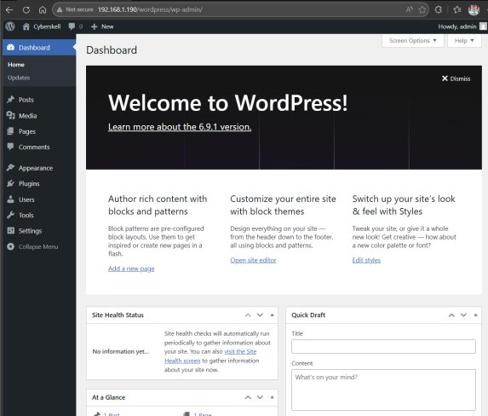
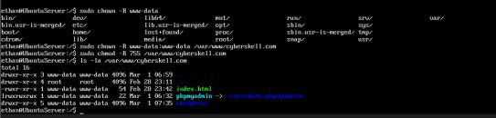
Installing & Securing WordPress
INSTALLATION STEPS
Download WordPress
wget https://wordpress.org/latest.tar.gz
Extract
tar -xzvf latest.tar.gz
Move to Web Root
sudo mv wordpress /var/www/cyberskell.com
Configure wp-config.php
DB_NAME, DB_USER, DB_PASSWORD
Set Permissions
sudo chown -R www-data:www-data
sudo chmod -R 755
Run Web Installer
http://192.168.1.190/wordpress
File permission hardening with chown & chmod this prevents non root users from hanging anything

Slide 10
Project Review and checkpoints
Domain & DNS
Registered cyberskell.com, configured BIND9 as authoritative DNS server with A and CNAME records
Web Server
Installed Apache on Ubuntu 24.04, configured virtual hosting for cyberskell.com
Security
Secured Apache with self-signed SSL/TLS certificate, implemented IP-based access control
Database
Installed and hardened MySQL, created dedicated WordPress database and user
Web Apps
Installed and configured phpMyAdmin and WordPress with proper file permissions

